Slide 1

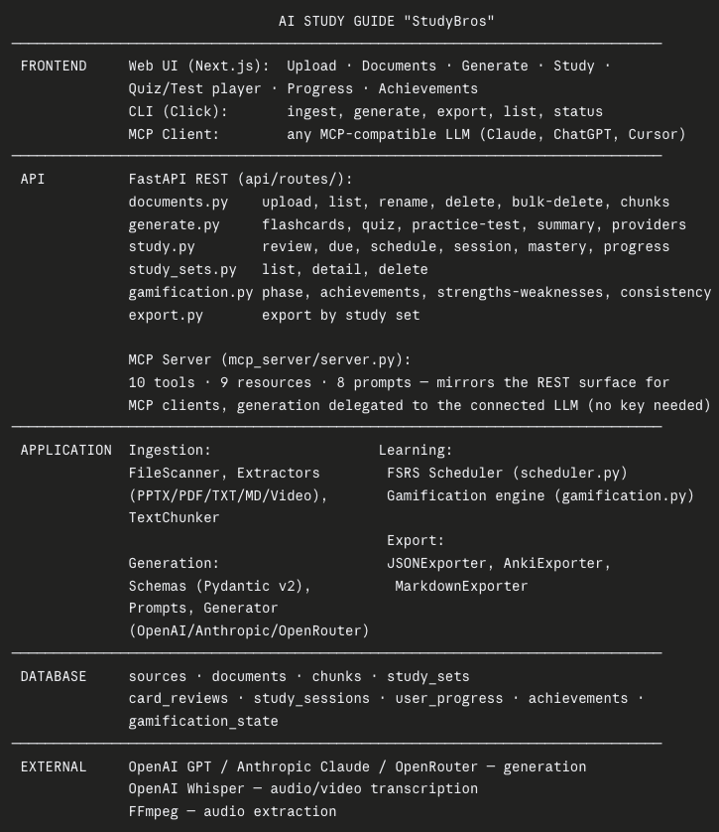
KNIGHT FOUNDATION SCHOOL OF COMPUTER AND INFORMATION SCIENCES
TEAM: KIRNEILL JOSEPH, DANIEL LABRADOR, GONCALO FERREIRA NASCIMIENTO, LENYN MURILLO
INSTRUCTOR: PROF. MASOUD SADJADI
OUR SOLUTION
Ingest → chunk → AI-generate flashcards, quizzes, and practice tests from a student's own material
FSRS v5 spaced repetition + Bloom's-taxonomy mastery tracking
Delivered three ways from one core library: web app, MCP server (use it from Claude/ChatGPT/Cursor with zero API key), and CLI Provider-agnostic generation (OpenAI, Anthropic, OpenRouter) — never locked to one vendor
STUDYBROS
PROBLEM
Students have the material (slides, PDFs, recordings) but not the time to turn it into usable study assets
Recall alone isn't mastery; most tools don't track whether a student actually understands a topic or just saw it once
Existing study apps require a separate account, a separate app, and a separate habit
ARCHITECTURE
RESULTS
211 automated backend tests passing, clean lint and type-checking across the codebase
Live-verified end-to-end: upload → generate → review → export, including real 20MB+ file uploads
Two structured UI/UX audits completed (WCAG 2.1 AA + performance + security), 152 findings identified and triaged — evaluation was real, not a formality
Shipped a fully working platform after losing a team member mid-project
REQUIREMENTS
Students converting lecture PDFs/slides into study material without manual prep
Self-learners generating quizzes from downloaded or recorded material
Core: ingest PDF/PPTX/TXT/MD/video, generate flashcards/quizzes/tests, schedule reviews by actual retention, run under 30 seconds per generation call

